Slide 1
Computer Communication & Networks
Lecture on
Introduction to Data Communication
*

Slide 2
Data Communications
The term telecommunication means communication at a distance. The word data refers to information presented in whatever form is agreed upon by the parties creating and using the data. Data communications are the exchange of data between two devices via some form of transmission medium such as a wire cable.
*

Slide 3
Fundamental Characteristics
The effectiveness of a data communication system depend on four fundamental characteristics:
  Delivery
  Accuracy
  Timelines
  Jitter
*

Slide 4
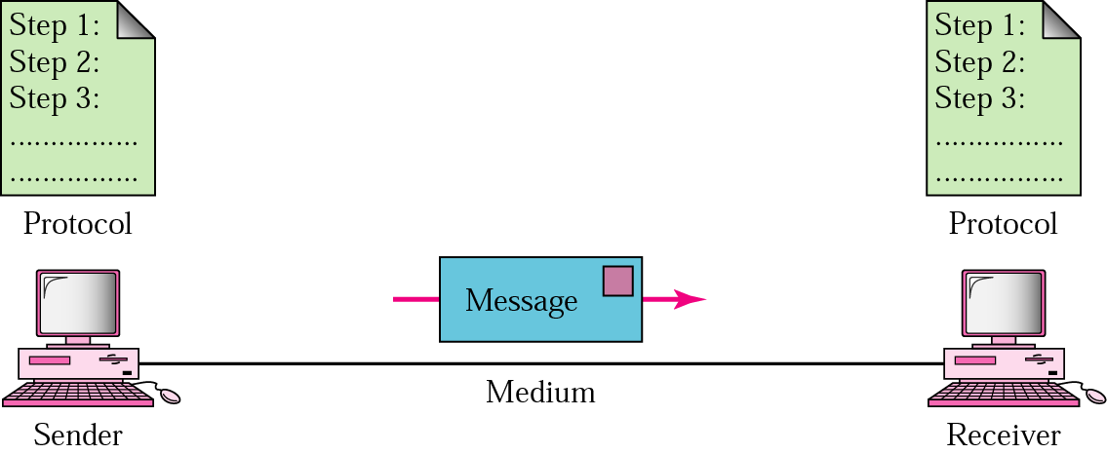
Five Components of Data Communication
Message
Sender
Receiver
Medium
Protocol
*

Slide 5
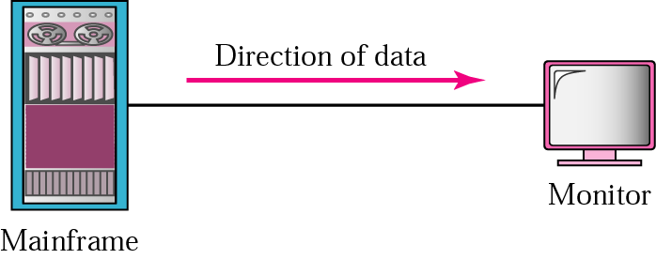
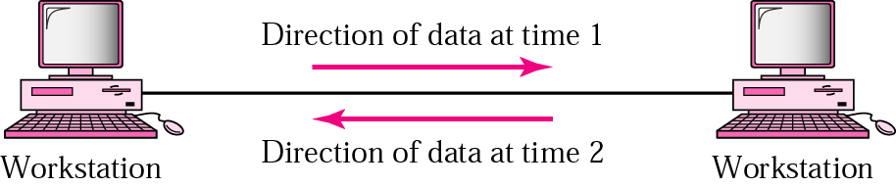
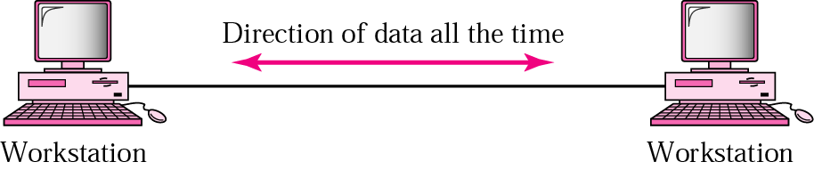
Direction of data flow
Simplex
Half Duplex
Full Duplex
*

Slide 6
Networks: key issues
Network criteria
  Performance
    Throughput
    Delay
  Reliability
    Data transmitted are identical to data received.
    Measured by the frequency of failure
    The time it takes a link to recover from a failure
  Security
    Protecting data from unauthorized access
*

Slide 7
Terminology
The throughput or bandwidth of a channel is the number of bits it can transfer per second
The latency or delay of a channel is the time that elapses between sending information and the earliest possible reception of it
*

Slide 8
Network topologies
Topology defines the way hosts are connected to the network
*

Slide 9
Network topology issues
a goal of any topology
high throughput (bandwidth)
low latency
*

Slide 10
Bandwidth and Latency
Bandwidth
1. telecommunications: range of radio frequencies: a range of radio frequencies used in radio or telecommunications transmission and reception
2. computing: communications capacity: the capacity of a communications channel, for example, a connection to the Internet, often measured in bits per second
3. a data transmission rate; the maximum amount of information (bits/second) that can be transmitted along a channel
Latency
A synonym for delay, is an expression of how much time it takes for transmission from one designated point to another
*

Slide 11

Categories of Topology
*

Slide 12
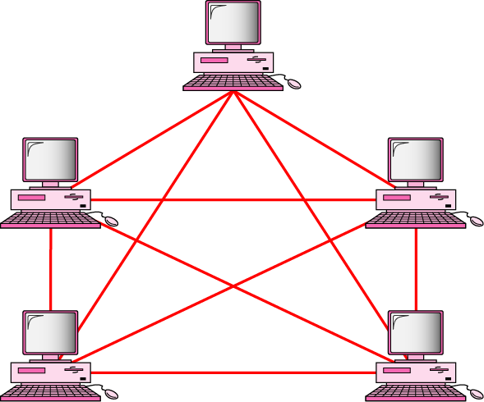
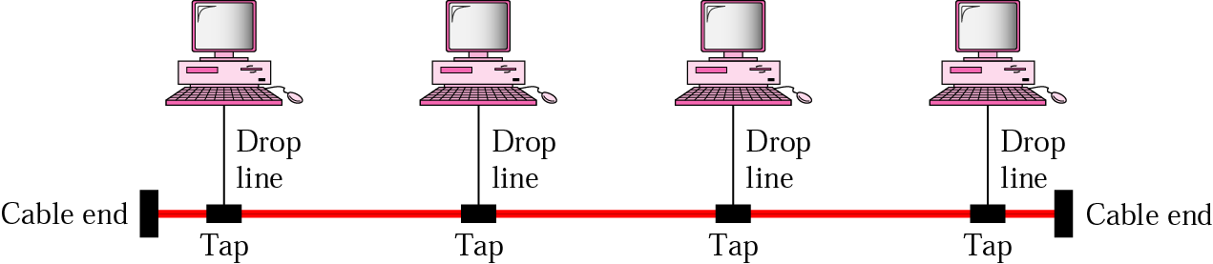
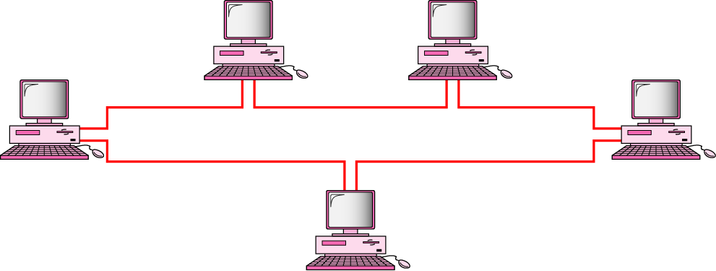
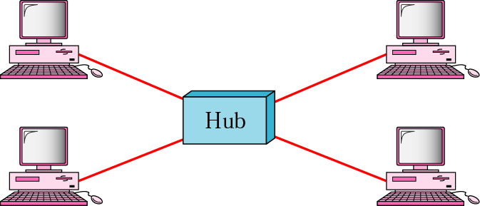
Mostly used network topologies
bus
mesh
ring
star
*

Slide 13

A hybrid topology: a star backbone with three bus networks
*

Slide 14

Hierarchical organization of the Internet
*

Slide 15
Layering & Protocol Stacks
*

Slide 16
What’s a protocol?
human protocols:
“what’s the time?”
“I have a question”
introductions
… specific msgs sent
… specific actions taken when msgs received, or other events
network protocols:
machines rather than humans
all communication activity in Internet governed by protocols
*

Slide 17



Protocol
protocols define format, order of msgs sent and received among network entities, and actions taken on msg transmission, receipt
a human protocol and a computer network protocol:
time
Hi
TCP connection
req.
Hi
TCP connection
reply.
Got the
time?
Get http://gaia.cs.umass.edu/index.htm
2:00
<file>
*

Slide 18
Standard
Essential in creating and maintaining an open and competitive market for equipment manufacturers
Guaranteeing national & international interoperability of data & telecommunication technology & process.
*

Slide 19
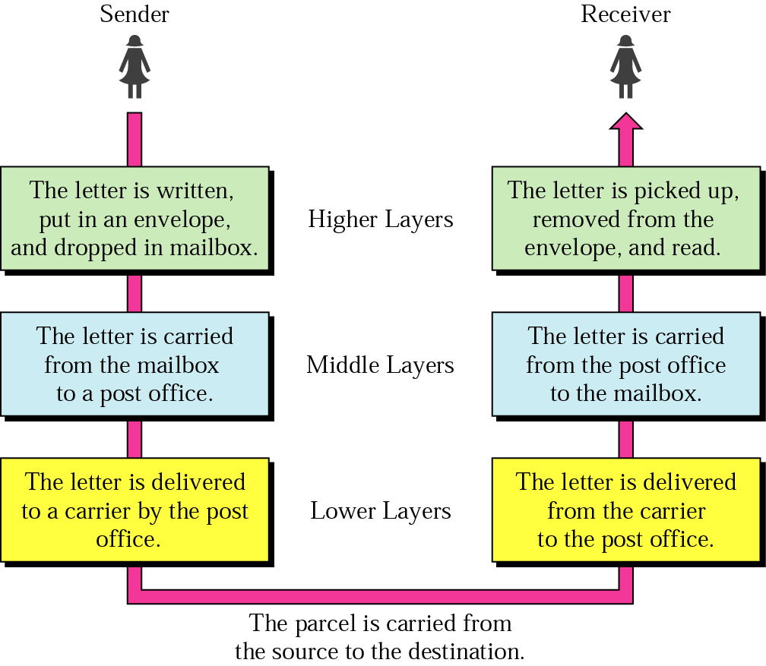




Layered Tasks
An example from the everyday life
Hierarchy?
Services
*

Slide 20
Why layered communication?
To reduce complexity of communication task by splitting it into several layered small tasks
Functionality of the layers can be changed as long as the service provided to the layer above stays unchanged
  makes easier maintenance & updating
Each layer has its own task
Each layer has its own protocol
*

Slide 21
Reference Models
OSI reference model
TCP/IP
*

Slide 22
OSI Reference model
Open System Interconnection
7 layers
Create a layer when different abstraction is needed
Each layer performs a well define function
Functions of the layers chosen taking internationally standardized protocols
Number of layers – large enough to avoid complexity
*

Slide 23

Seven layers of the OSI model
*

Slide 24

Exchange using OSI Model
*

Slide 25

The interaction between layers in the OSI model
*

Slide 26
Issues, to be resolved by the layers
Larger bandwidth at lower cost
Error correction
Flow control
Addressing
Multiplexing
Naming
Congestion control
Mobility
Routing
Fragmentation
Security
....
*

Slide 27
OSI Layers
*

Slide 28
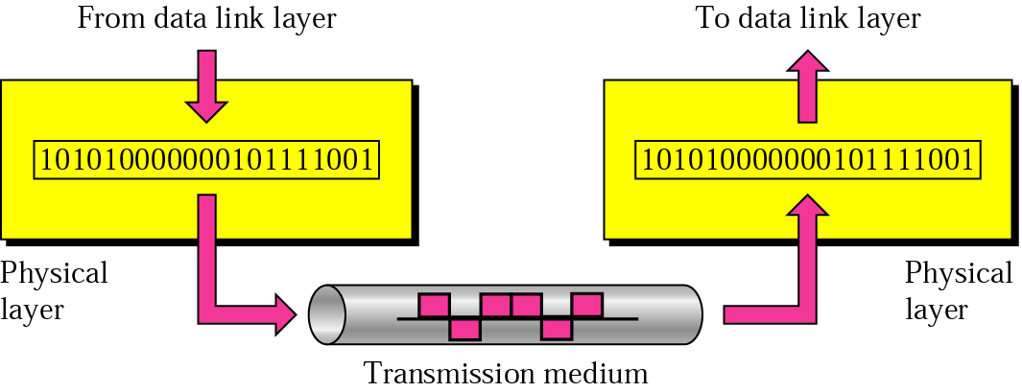
Physical layer
physical
connection
Transporting bits from one end node to the next
type of the transmission media (twisted-pair, coax, optical fiber, air)
bit representation (voltage levels of logical values)
data rate (speed)
synchronization of bits (time synchronization)
*

Slide 29

Note
The physical layer is responsible for movements of
individual bits from one hop (node) to the next.
*

Slide 30
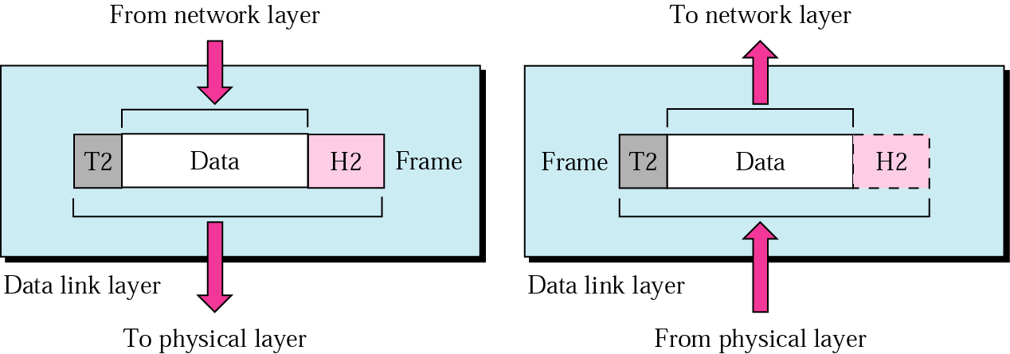
Data Link layer
logical
connection
Transporting frames from one end node to the next one
- framing - physical addressing
- flow control - error control
access control
*

Slide 31
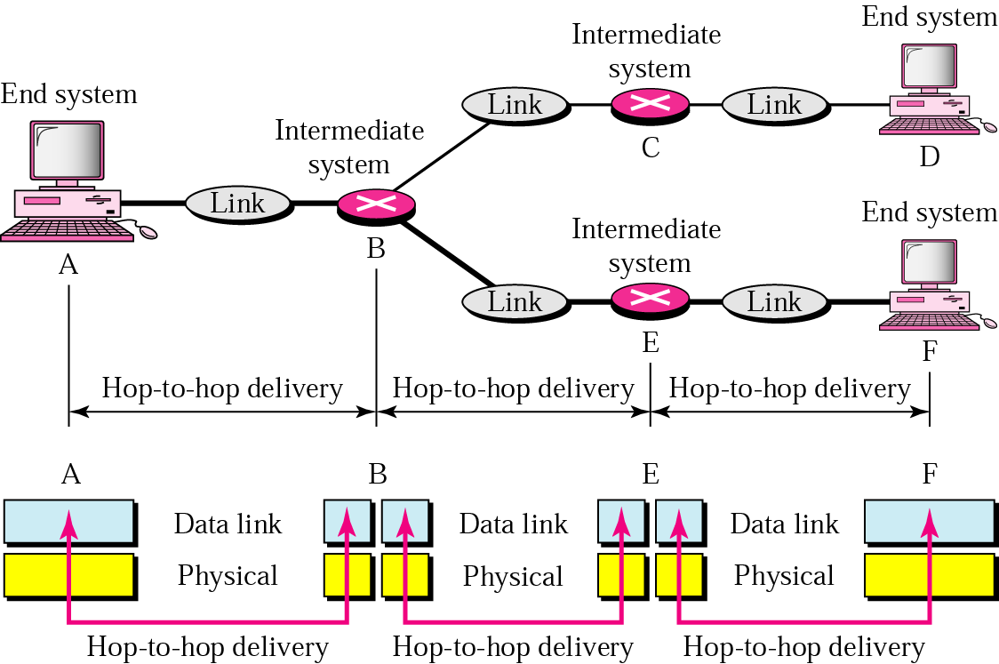
Data Link layer
- hop-to-hop delivery-
*

Slide 32
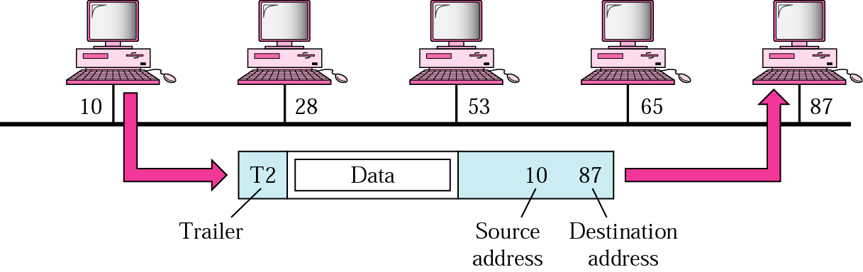
Data Link layer
- example-
*

Slide 33
Note
The data link layer is responsible for moving
frames from one hop (node) to the next.
*

Slide 34



